Slide 1


Slide 2
2025 NDACo Annual Conference
"Need to Know”

Slide 3
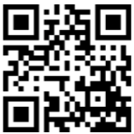
GET THE YAPP APP
To install, scan this code or, using your phone, go to my.yapp.us/NDACO
Allows you to set your own schedule and still see full schedule
Easy to find details about events and workshops
Maps, Floor Plans and other helpful lists
A tip sheet to remind you of what you learned in this presentation
A list of other pre-registered attendees!
Notes:
Over 400 have the app – 33 new since yesterday.
Once you have it, you do have to tap on the logo, then a brief sponsor screen appears before it goes to the schedule

Slide 4

GET THE YAPP APP
Tabs on bottom of screen:
Daily Schedules
NDDOT Schedule
Maps and Floor Plans
Important Tips
Important Faces
ooo means "more"
More:
Boards, Committees, Delegates
Elite Prize List + Winning Numbers
Sponsors
Pre-Registered County Attendees
Notes:
Talk about how we add winning numbers Monday eve

Slide 5
GENERAL INFORMATION
There are FOUR fundraisers to help our scholarship fund this year.
LOTTO: Buy tickets $1 ea.(FREE GIFT if you by 5 or more) at the Registration Desk
Winner announced at Tuesday's lunch – Prize is a FREE TRIP TO 2025 NACo ANNUAL CONFERENCE IN New Orleans! (July 17-20)
RAFFLE: Buy tickets $1 ea. Keep the coupon side marked "Keep" and put the other in boxes at Elite Exhibits for a chance to win the prize on display at those booths.
70/30 CASH DRAWING, buy tickets at the Monday evening entertainment event after dinner. Cash and prizes will be awarded.
THIS YEAR ONLY – a Dunk Tank! Three throws for $5 to dunk Aaron Birst, Ryan Gellner or Don Flaherty
***There's an ATM in the lobby.
Notes:
Explain the NDACo Scholarship Fund
Talk about fan and show it if you can

Slide 6
GENERAL INFORMATION
Wear comfortable clothes and shoes, and bring a light jacket or vest in case rooms are cold
Phone charging stations will be available at Member Central
SUNDAY Social Upper Level Atrium MONDAY Social Exhibit Area
NDCCA Business meeting (Monday 3:15) is for ALL COMMISSIONERS
DELEGATES know who they are. They meet 7:30 am on Tuesday in Hall A with breakfast.
The word DELEGATE will be printed in orange on delegates’ name badges.
Notes:
"business casual" including jeans
Stress the business meeting had only 30 voters last year of over 100 registered commissioners

Slide 7
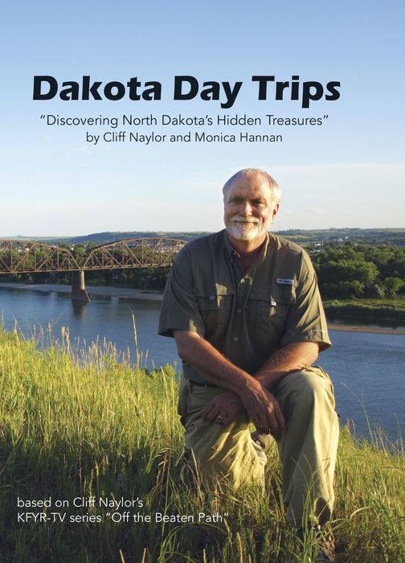
GENERAL INFORMATION
Our STAFF wear black shirts and have green lanyards. We are there to help you!
The Registration Desk is usually the best place to go for emergencies or to urgently reach a staff person or fellow attendee.
To encourage you to stay through the entire conference, we are offering one FREE registration for ANY COUNTY
Must have at least ONE Commissioner and ONE other official attend the final session Tuesday.
Name badges will be collected as proof of attendance following the closing keynote speech.

Slide 8
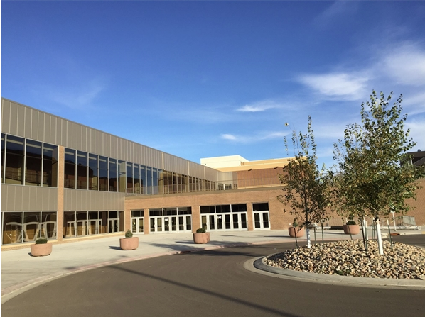
EVENT CENTER Front Entry
Notes:
Southwest corner on 5th Street and Bowen Avenue

Slide 9
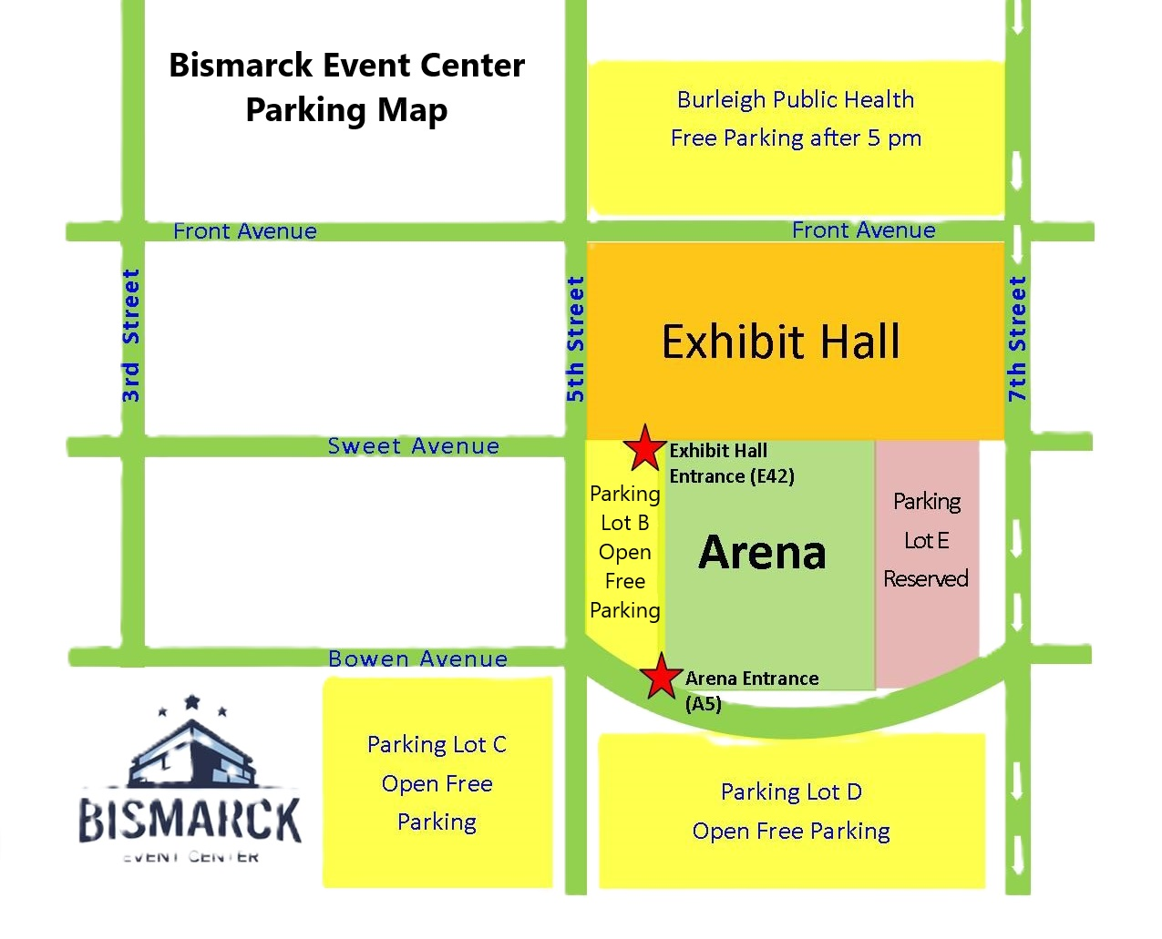
EVENT CENTER
University of Mary parking evenings only

Slide 10
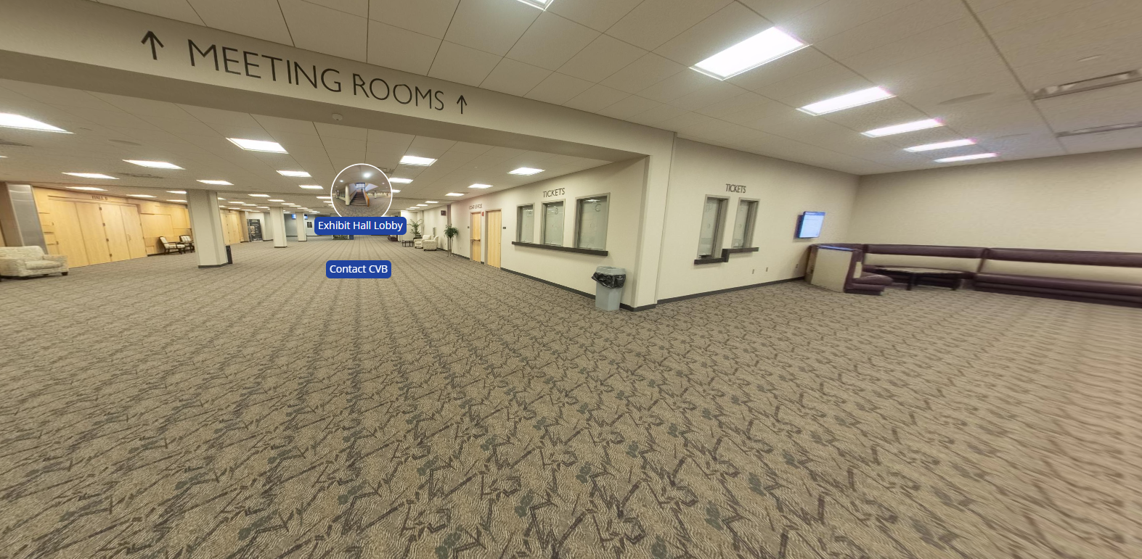
EVENT CENTER Registration Desk
Notes:
Main Floor Lobby Area
Point out these are stock photos
Exhibit Hall (bismarckeventcenter.com)

Slide 11
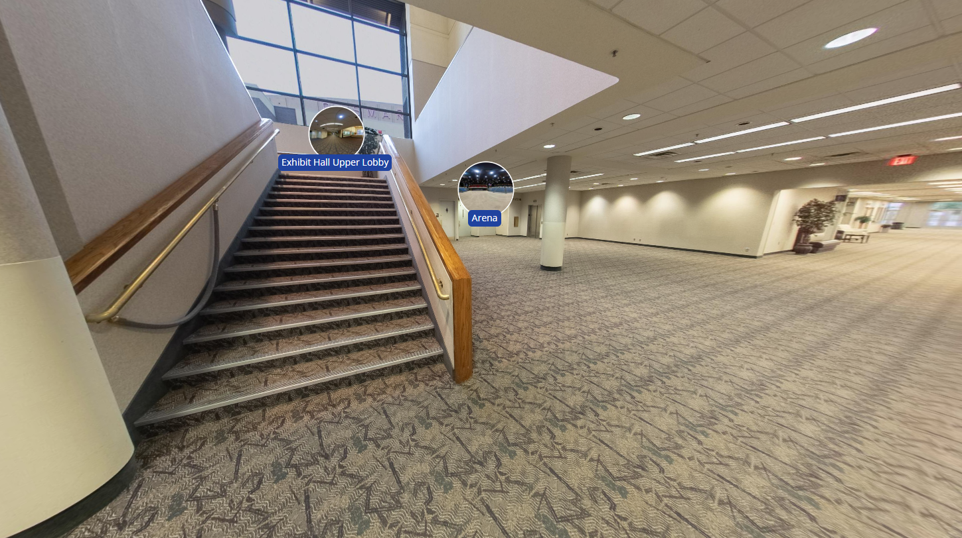
EVENT CENTER NDDOT and Workshop Stairs
Notes:
Elevator is also available
Mention that the NDDOT room (PR106) is where you see "arena" bubble

Slide 12
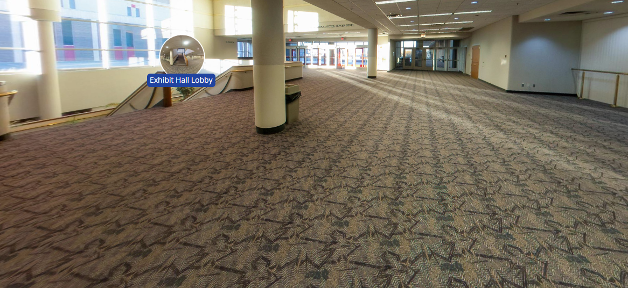
EVENT CENTER Upper Level Atrium
Notes:
Sunday Welcoming Social
Tuesday Grab-n-Go Breakfast

Slide 13
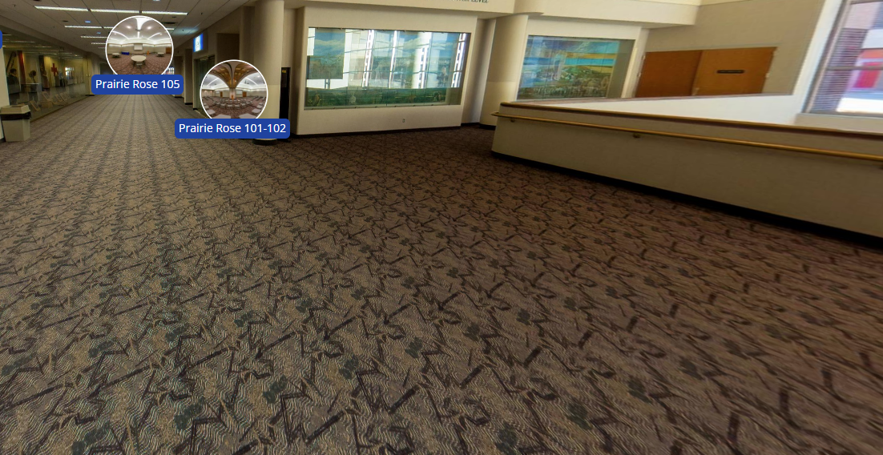
EVENT CENTER Workshop Lobby – Upper Level

Slide 14
CHANGES FROM RECENT YEARS
ALL events are at the Bismarck Event Center.
Two Receptions: Sunday in the Upper-Level Atrium, Monday in the Exhibitor Area
If you signed up for only one day, you are welcome to join us at the reception the evening before.
Monday morning General Session will be live-streamed at ndacolive.com.
All Member Association meetings will be held in the Upper Level
No official meals or meetings will be held at any other location
MONDAY: 7:00 to 8:15 will be a continental breakfast buffet in Hall A
TUESDAY: 8:00 to 8:45 Continental Breakfast in Atrium
TUESDAY DELEGATES ONLY: 7:30 full breakfast in Hall A
Notes:
MEMBER ASSOCIATION MEETINGS
Recorders will be held on Sunday afternoon
All other member association meetings will be Monday afternoon

Slide 15
CHANGES FROM RECENT YEARS
Monday evening transportation
West River will have vans rotating through every 30 minutes beginning 4:30
No sign-up needed – Phone numbers will be shared soon or on-site
Monday evening theme party
Dress for the County Fair theme and make the evening more fun at the Photo Booth
While we’re counting $$ from the 70/30 scholarship fundraiser
Trivia, a Dunk Tank and music from NOVA
Notes:
if they are already at the EC and taking their car to a hotel, they can ask him to meet them at the hotel and bring them back. Ideally, this is a loop as well but no, he can't be put "on-call" per say. That's not a service they offer. They would have to coordinate with the driver before he leaves. Another option is to get a uber/lyft or hotel shuttle to EC so they don't leave their car there.

Slide 16
CHANGES FROM RECENT YEARS
Nationwide will be available for one-on-one meetings for you to review your 457 retirement plan or discuss why you should have one). Use this link to schedule: https://bit.ly/NDACOConference-Nationwide-DeferredCompMeetings
Stop by “Member Central” in the Exhibit Hall at the Event Center during networking breaks for FREE County Fair Piggy Soaps!
Member Central is where you can visit with our staff about NDACo, the conference, or anything else that's on your mind, and register with the County Employer Group (CEG) for a free office chair!
Notes:
In past years, we would have asked you for a special ticket, but just stop by – your name tag entitles you to the gift.
Our staff wants to meet you and answer any questions you may have.

Slide 17
CHANGES FROM RECENT YEARS
You'll get ILG Hours just for attending
Full conference attendees earn 6 FREE ILG hours
Monday only attendees earn 2.25 FREE ILG hours
Tuesday only attendees earn 3.75 FREE ILG hours
State's Attorneys qualify for 6 CLE credits (Event# 20241021NDAC)
No more pre-stuffed bags! Pick up your conference bag and materials when you register
No more Commissioner or Delegate ribbons on name badges
Notes:
Commissioner already says so on badge, Delegate will be printed in ORANGE

Slide 18
Will it be streamed online?
The opening general session will be. A link will go out soon.
We will send the link out this week and encourage sharing it with your colleagues who can’t be there.

Slide 19

Questions?
This recording will be posted at www.ndaco.org/annual-conference, so you can watch it again and again and again.
Email your questions to: jeff.eslinger@ndaco.org
Notes:
Have Alisha mention they can make suggestions on the follow-up survey.

